Slide 1
Search Engine Architecture
Hongning Wang
CS@UVa

Slide 2
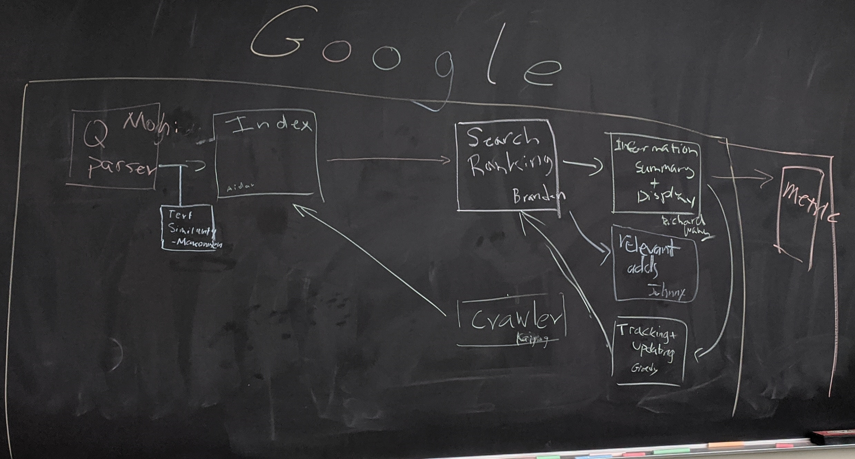
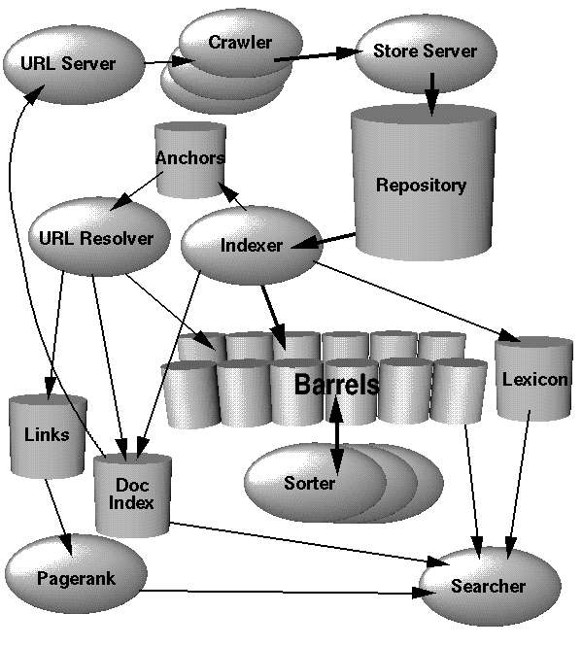
Classical search engine architecture
“The Anatomy of a Large-Scale Hypertextual Web Search Engine” - Sergey Brin and Lawrence Page, Computer networks and ISDN systems 30.1 (1998): 107-117.
Crawler and indexer
Citation count: 18,938 (as of January 21, 2020)
Query parser
Ranking model
Document Analyzer

Slide 3
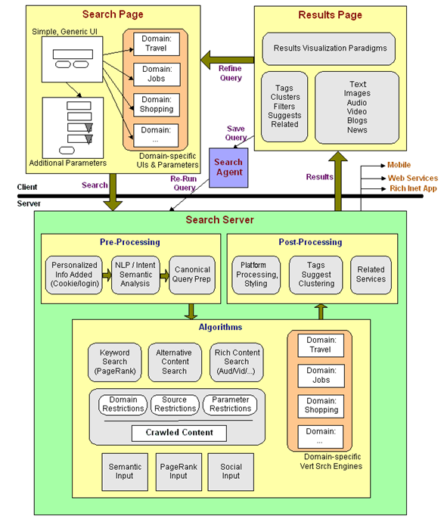
User input
Result display
Result post-processing
Query parser
Ranking model
Domain specific databases
Crawler & Indexer
Document analyzer & auxiliary database

Slide 4
Abstraction of search engine architecture
Indexed corpus
Crawler
Ranking procedure
Research attention
Feedback
Evaluation
Doc Analyzer
(Query)
Query Rep
User
Doc Representation
Ranker
Indexer
results
Index

Slide 5
Core IR concepts
Information need
“an individual or group's desire to locate and obtain information to satisfy a conscious or unconscious need” – wiki
An IR system is to satisfy users’ information need
Query
A designed representation of users’ information need
In natural language, or some managed form

Slide 6
Core IR concepts
Document
A representation of information that potentially satisfies users’ information need
Text, image, video, audio, and etc.
Relevance
Relatedness between documents and users’ information need
Multiple perspectives: topical, semantic, temporal, spatial, and etc.
One sentence about IR - “rank documents by their relevance to the user’s information need”

Slide 7
Key components in a search engine
Web crawler
An automated program that systematically browses the web for the purpose of Web content indexing and updating
Document analyzer & indexer
Manage the crawled web content and provide efficient access of web documents

Slide 8
Key components in a search engine
Query parser
Compile user-input keyword queries into managed system representation
Ranking model
Sort candidate documents according to it relevance to the given query
Result display
Present the retrieved results to users for satisfying their information need

Slide 9
Key components in a search engine
Retrieval evaluation
Assess the quality of the returned results
Relevance feedback
Propagate the quality judgment back to the system for search result refinement

Slide 10
Key components in a search engine
Search query logs
Record users’ interaction history with search engine
User modeling
Understand users’ longitudinal information need
Assess users’ satisfaction towards search engine output

Slide 11
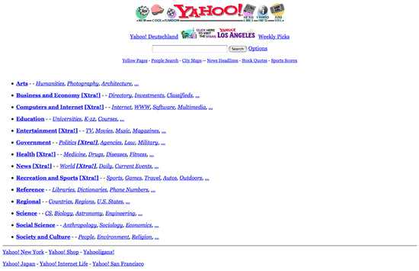
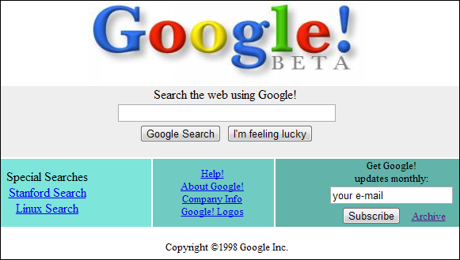
Discussion: Browsing v.s. Querying
Browsing – what Yahoo did before
The system organizes information with structures, and a user navigates into relevant information by following a path enabled by the structures
Works well when the user wants to explore information or doesn’t know what keywords to use, or can’t conveniently enter a query (e.g., with a smartphone)
Querying – what Google does now
A user enters a (keyword) query, and the system returns a set of relevant documents
Works well when the user knows exactly what query to use for expressing her information need

Slide 12
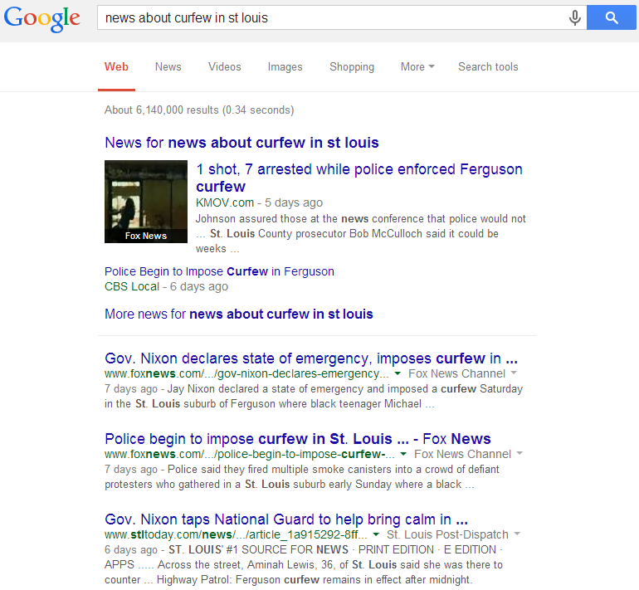
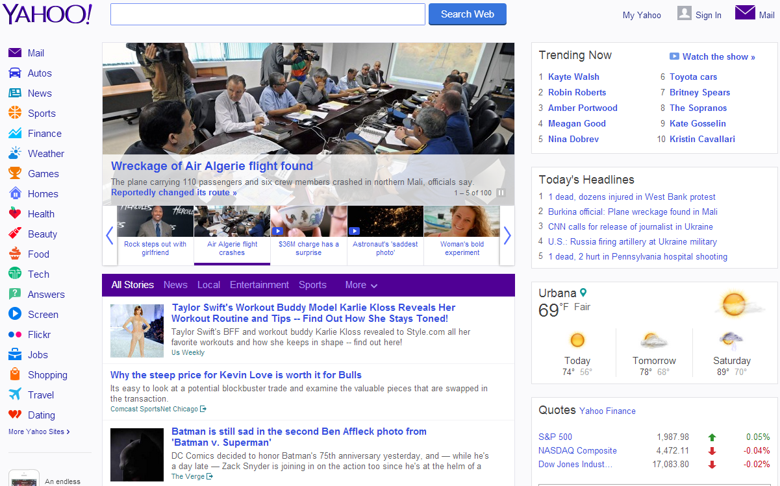
Pull vs. Push in Information Retrieval
Pull mode – with query
Users take initiative and “pull” relevant information out from a retrieval system
Works well when a user has an ad hoc information need
Push mode – without query
Systems take initiative and “push” relevant information to users
Works well when a user has a stable information need or the system has good knowledge about a user’s need

Slide 13
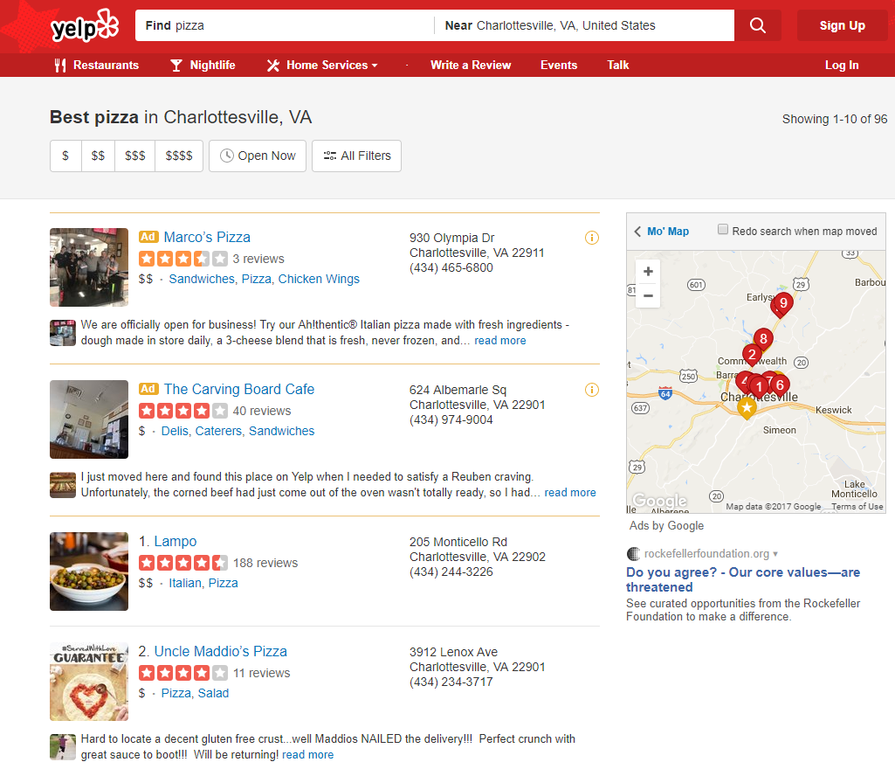
Question: is Yelp a search engine?

Slide 14
What you should know
Basic workflow and components in an IR system
Core concepts in IR
Browsing v.s. querying
Pull v.s. push of information

Slide 15
Today’s reading
Introduction to Information Retrieval
Chapter 19: Web search basics

